Slide 1
Using Liferay Objects to Create Custom Business Objects
Liferay DXP Basics
Business
Liferay DXP 7.4

Slide 2
Key Module Takeaways
Liferay Objects provides a low-code way to create custom business objects through the Liferay DXP UI.
Objects define the information an application collects and manages. Non-developers can define fields, layouts, and relationships for Objects.
Objects can be integrated into Liferay Workflow, Permission, and Asset Frameworks for improved out of the box usability.
Objects are deployed as Widgets and entries displayed as collections.

Slide 3
Exercise Prerequisites
Unzipped module exercise files in the following folder structure:
Windows: C:\liferay
Unix Systems: [user-home]/liferay
Liferay DXP 7.4 set up and running
If you have not started your Liferay instance yet, set it up with the following basic configuration:
Portal Name: Mondego
First Name: Test
Last Name: Test
Email: test@modego.com
Notes:
Check out the Liferay Foundations: Introduction to Liferay DXP course if you have questions on starting a new instance of Liferay DXP

Slide 4
Use Case: The Mondego Group
The Mondego Group collects information submitted by customers when they open new accounts. Mondego can use Liferay Objects to:
Manage how information is collected and stored in Liferay DXP
Create custom forms and workflows integrated with Objects
Define relationships between business objects (e.g., applications and account types)
Notes:
(Add Image)

Slide 5


Relevant KPIs for Module
Improve efficiency of processing applications by integrating Objects with Workflow
Reduce the collection of extraneous user data
Decrease the amount of time needed to create custom business objects and applications

Slide 6
Creating New Objects

Slide 7
What are Objects?
Liferay Objects is a low-code way to build and deliver applications without writing code or deploying modules
Objects define the information an application collects and manages
In Objects you can add custom data fields, define complex relationships, design custom layouts, and define Object scope
From creation, all Objects are fully integrated with Liferay's core frameworks
Notes:
Notes:
Liferay Objects is introduced in Liferay DXP 7.4 for low-code development, replacing the App Builder of DXP 7.3.
The Objects application allows you to quickly develop solutions, allowing non-developers to customize Liferay DXP to fit business needs.
Use Case:
With Liferay Objects, Mondego's web team can quickly create applications to use across the platform. The team can create a custom New Account Object that integrates with other Liferay frameworks so that new customers can easily fill out their applications. The team can accomplish this and more with worrying about integrations, writing code, or deploying modules.

Slide 8
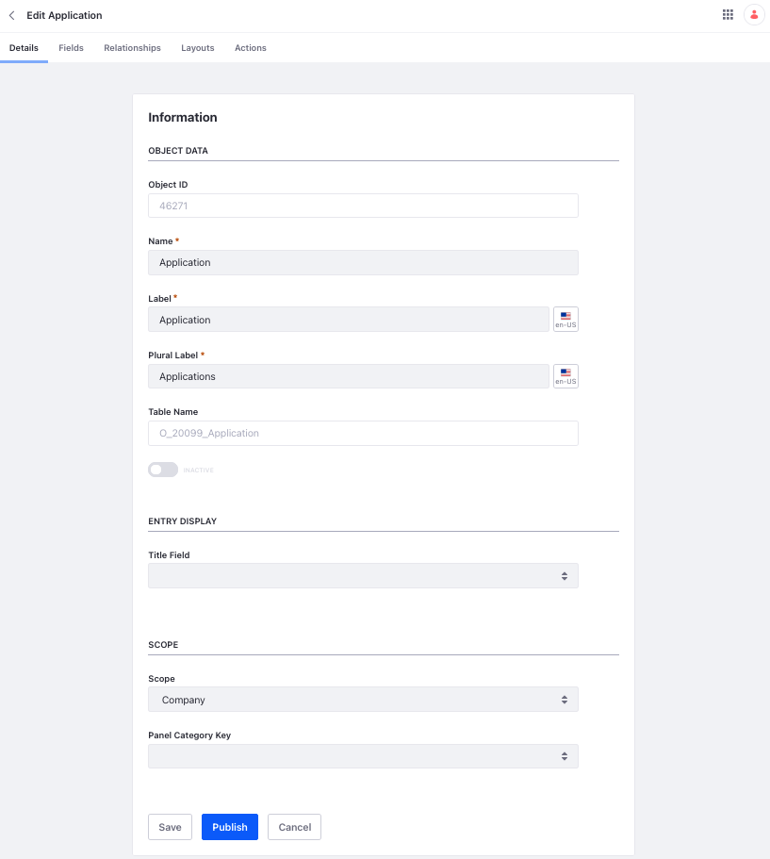
Creating and Managing Objects
Objects are created using the Objects portlet in Liferay DXP
To create a new Object:
First, create a draft of the object
Then, edit the draft to include fields, scope, relationships, and more
Finally, publish the draft to create the new application
Once published, the Object cannot be deleted, and the Name and Scope cannot be changed
Notes:
Notes:
Scope refers to the scope of the data. A company scoped Object stores data per Liferay instance while a Site scoped Object’s data is stored per Site.
Additionally, the scope determines where in navigation the Object can show up. Site scoped objects can be placed in the Site Menu while company scoped Objects can be displayed in the Control Panel.
In addition to the Name and Scope being locked after publication, any fields or relationships added during the draft phase will also be locked once the Object is published. The Table Name cannot be changed at any time once an Object draft is generated.
Use Case:
For the Mondego team’s New Account object, they decide to add a few fields right from the start, including Name and Account Type. Additionally, they decide to scope the Object to the Site, so each banking Site stores a unique dataset of New Account submissions rather than all New Account submissions being saved at the instance level regardless of location.

Slide 9
Adding Fields
Fields are data definitions that represent a database column and store different types of values for Liferay Objects
Field Types include:
Fields can be added to the Object draft or after the Object has been published.
Fields can be mandatory or optional and can be searchable or not
BigDecimal
Boolean
Date
Double
Integer
Long
Picklist
String
Notes:
Notes:
The Field Types available for Objects include:
BigDecimal: high precision numerical value with a decimal point, used for calculations
Boolean: a logical, binary value of either true or false
Date: a value indicating a specific day, month, and year
Double: a 64 -numerical value with a floating point
Integer: a 32-bit numerical value without a floating point
Long: a 64-bit numerical value without a floating point
Picklist: a string value stored in a picklist
String: a sequence of characters (letters, numbers, punctuation)
Use Case:
Mondego’s New Account Object can use a collection of these fields. For instance, the String Field is used for Names, the Date field for Date of Birth, the Boolean for a Yes or No question about whether the customer has ever made an account with Mondego before, and the Picklist to provide a list of options for Account Types.

Slide 10
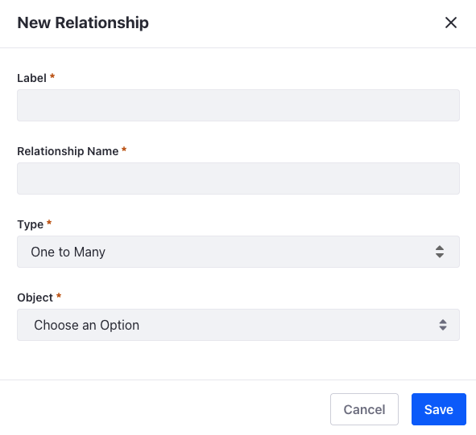
Defining Object Relationships
Relationships are connections between Objects
Liferay Objects provides two types of relationships
One to Many: one of the current Object's entities can be related to multiple entities in another Object (database table creation)
Many to Many: multiple entities in the current Object can be related to multiple entities in another Object (database table creation)
Notes:
Notes:
You must create a custom layout to display relationships for Object entries.
For One to Many, the generated table adds an entity representing the “One” (or “parent”) on the ”Many” (or “child”) side. The new table can be added to a Relationships Tab on the parent side.
For Many to Many, a new database table is created for both sides. The table can be added to a Relationships Tab in either Object’s custom layout.
Use Case:
For our use case, the New Account Object needs to be connected to the Account Type Object. The ideal relationship for this is a One to Many: One Account Type to Many New Accounts. When this relationship is created, the Account Type entity will show up as a new field in the New Account Object.

Slide 11
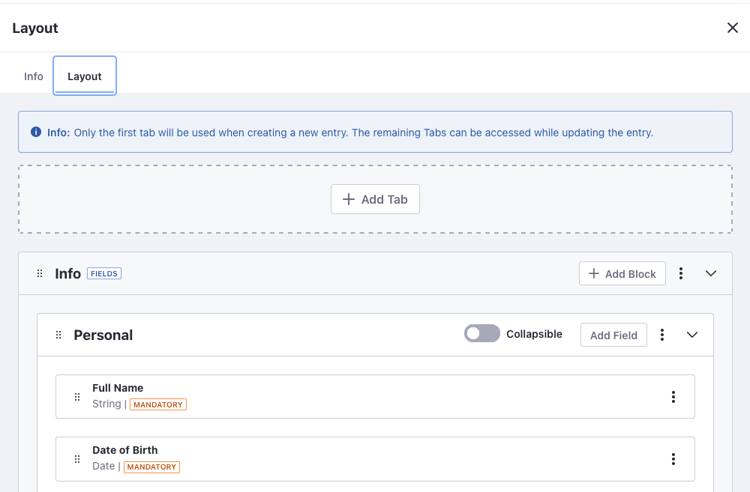
Designing Object Layouts
Object Layouts define how fields and relationships are organized and displayed when creating or editing an entry
The default layout is one tab with fields displayed in alphabetical order, but custom layouts allow you to add multiple tabs and manage field and relationship organization
Two types of tabs exist:
Fields
Relationship
Notes:
Notes:
Tab types:
Fields: used to display Object entry fields
Relationship: used to display relationship tables and must be used for displaying parent side of one-to-many relationships/both sides of many to many
Use Case:
Rather than displaying all fields in alphabetical order on one page (the default), the web team can create a new display template for the New Account Object. The first tab could ask for personal information and the second tab could focus on account-specific details.

Slide 12
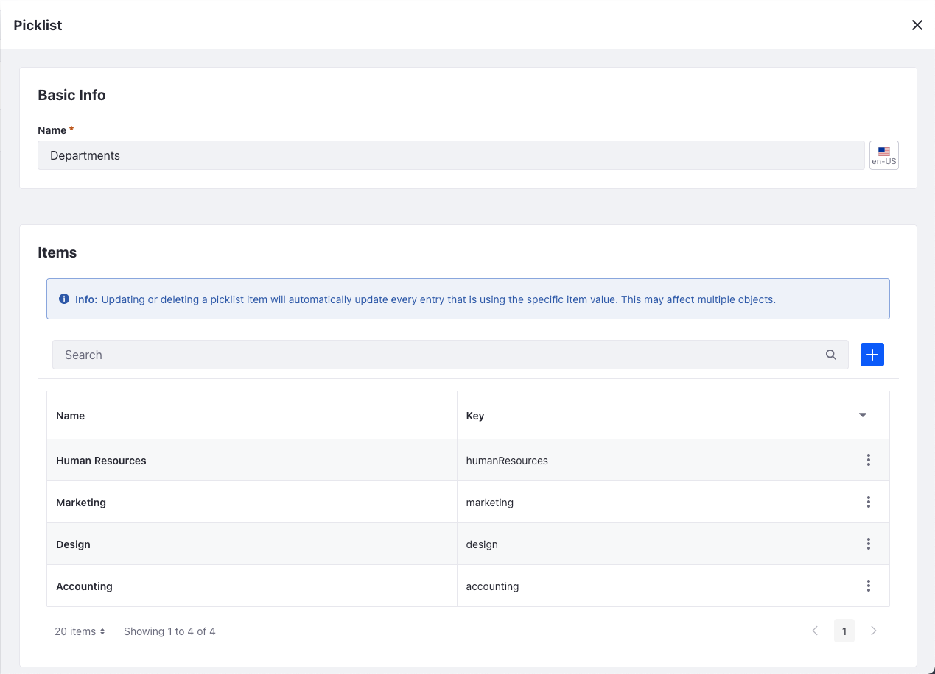
Picklists
Picklists is an application for creating standard lists of values
By adding items to a list, the list can then be used in supported applications
For example, creating a Picklist allows you to select the Picklist Field Type when adding Fields to an Object
Notes:
Notes:
The Picklist Field Type will not be available unless a Picklist has been created.
A list cannot be deleted if used by an Object field, but list items can be edited and removed
Updating or deleting a Picklist item will automatically update all Object entries using the item
Use Case:
For recurring values, the Mondego team can create Picklists. Another Object for PTO Requests has a field for Departments. Rather than requiring each employee to manually enter their department, the team can create a Picklist called “Departments” that contains all available options (e.g. Human Resources, Marketing, Engineering, etc.). This Picklist can be used across any Object that has a Field set to the Department Picklist.

Slide 13
Publishing Objects
When an Object is published, the following operations take place:
A database table is created for the Object with the data definitions
A new Headless API is created for CRUD operations
A Collection Provider is created for displaying Object entries
The Object is integrated with Info, Permissions, Workflow, and Form frameworks
Once an Object is published:
It cannot be deleted
The Name and Scope cannot be changed
The Relationships and Fields created before publication cannot be removed
Notes:
Notes:
Certain elements cannot be changed once the Object is published, so remember to check the Name and Scope before publishing.
Although Objects cannot be deleted, they can be deactivated to hide from Users.
Any Fields and Relationships created before the Object is published cannot be removed. Additional fields and relationships can be added to the Object after publication, and any added fields can be deleted.
Use Case:
Once the Mondego team publishes the New Account Object, they can begin using the Object wherever it is needed on the platform.

Slide 14
Use Case: Mondego Applications and Requests
Mondego can use Objects to create custom applications for New Accounts:
When new customers open a Mondego Bank Account, the information added to the New Account Object will automatically be saved to the respective database table
Mondego can also create a custom Object for internal Requests:
When an employee needs to make a request for PTO, their information is collected in the database table for PTO requests
Mondego can improve organization of this data by creating a Picklist for Departments so employees can select their department when they submit requests

Slide 15
Knowledge Check
Liferay Objects allows Mondego to create custom applications without writing code.
When creating a New Account Object, different fields can be added with each storing a different type of value, including Boolean, Date, Double, Integer, String, and others.
Mondego can create connections between different objects using relationships:
One to Many
Many to Many
Mondego can create a Departments Picklist to store a standard list of values that can be used in supported applications.

Slide 16
Knowledge Check
Liferay Objects allows Mondego to create custom applications without writing code.
When creating a New Account Object, different fields can be added with each storing a different type of value, including Boolean, Date, Double, Integer, String, and others.
Mondego can create connections between different objects using relationships:
One to Many
Many to Many
Mondego can create a Departments Picklist to store a standard list of values that can be used in supported applications.

Slide 17
Exercise: Create a Custom Business Object
Notes:
Exercise Title
Use this slide to indicate that the following slides outline an exercise associated with the topic that is being covered. If a topic has multiple associated exercises, place one of these slides before the first exercise and between each of the subsequent exercises.

Slide 18
Create a Custom Business Object Exercise Objectives
Create a Liferay Object for New Accounts
Create a Liferay Object for PTO Requests

Slide 19

Create a Custom Business Object Exercise Steps
Create a Picklist for Account Types
Create a Liferay Object for New Accounts
Add Entries for the New Accounts Object
Create a Picklist for Mondego Departments
Create a Liferay Object for Internal PTO Requests
Create Some PTO Requests Using the PTO Request Object

Slide 20

Create a Custom Business Object Bonus Exercises
Create a new Liferay Object for Account Activity. Be sure to include fields for Customer Name, Transaction Amount, Account Number, and Account Type.

Slide 21
Integrating and Displaying Liferay Objects

Slide 22
Integrating Objects with Liferay
By default, all Objects are fully integrated with Liferay's core frameworks from creation, including:
Permissions
Workflows
Forms
Assets
Headless REST APIs
Notes:
Notes:
Since Objects are fully integrated with Liferay’s core frameworks from the start, it is easy to provide a unified experience across the platform.

Slide 23
Permissions Framework Integration
Since Objects are automatically integrated with the Permissions framework, you can assign application and resource permissions to manage access to the Objects and their entries
Permissions for Objects include:
Access to the Object in the Control Panel or Site Menu
Add Object Entry
Update, Delete, and View
Notes:
Notes:
Liferay's role-based access control ensures that only appropriate users can view and use an application's data
Permissions for Objects are split into two categories, Application Permissions and Resource Permissions.
Application Permissions include:
Access in Control Panel
Configuration
Permissions
Preferences
View
Resource Permissions include two subcategories, Resource-Related Actions (Add Object Definition, Extend System Object Definition, Permissions, Publish Object Definition) and Actions on Database Entities (Delete, Permissions, Update, View).
As with all permissions in Liferay DXP, permissions for Objects must be defined for a particular Role, and then the Role must be assigned to a User to take effect.
Use Case:
As with most things in Liferay DXP, Mondego can create Roles with set permissions to determine who can create, manage, and add to Objects. For example, entries can only be made to the Object Account Type by Site Administrators whereas New Account entries can be made by Site Users.

Slide 24
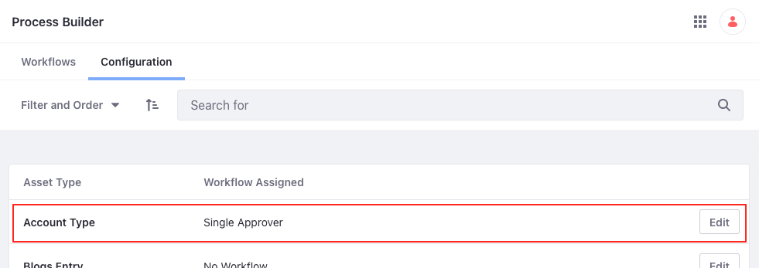
Integrating Objects with Workflow
Object entry creation can be set to follow a defined review and approval process using Workflows
By default, Liferay DXP offers either No Workflow or Single Approver Workflow, though additional Workflows can be created to better fit certain Objects
Notes:
Notes:
Once again, since Objects are automatically integrated with the Workflow framework, adding workflow steps to Object entry is simply a matter of setting the desired workflow.
By default, no workflow is set for Object entries. Adding the Single Approver workflow (the default workflow provided in Liferay DXP) will then require that an Administrator review and approve of the new entry before it is officially added.
Use Case:
To make sure that only valid entries are saved, Mondego can implement a Workflow on Object entries. For example, New Account submissions must be approved by a Site Administrator.

Slide 25
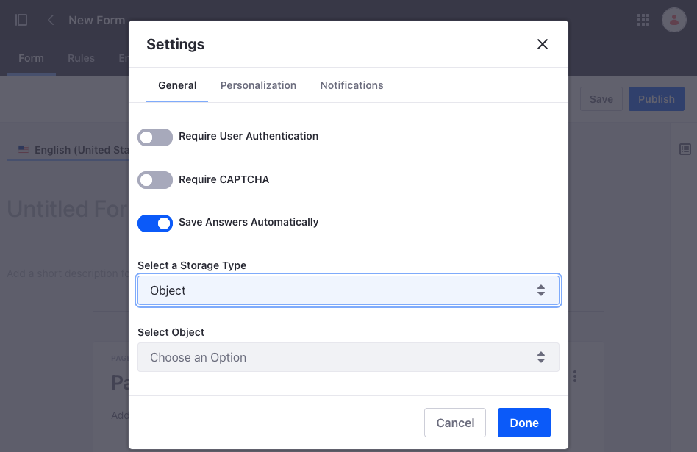
Creating Forms with Objects
Integrating Objects with Forms allows you to collect data using a Form and store that information in the Object database
By setting an Object as the Storage Type, you can match the form fields to the Object fields
Once the Form is created, a shareable link is generated which can then be used to collect information
Notes:
Notes:
By default, Forms save entries in a separate Entries tab next to the Form and Rules tabs.
Forms created from Objects, however, save the Entries under that particular Object.
Use Case:
Mondego Banking has an Object for New Accounts. By integrating that Object with Forms, they can create a Forms link that anyone can access. Any responses to that Form will automatically be saved in the New Accounts Object, which Mondego has placed in the Site Menu.

Slide 26
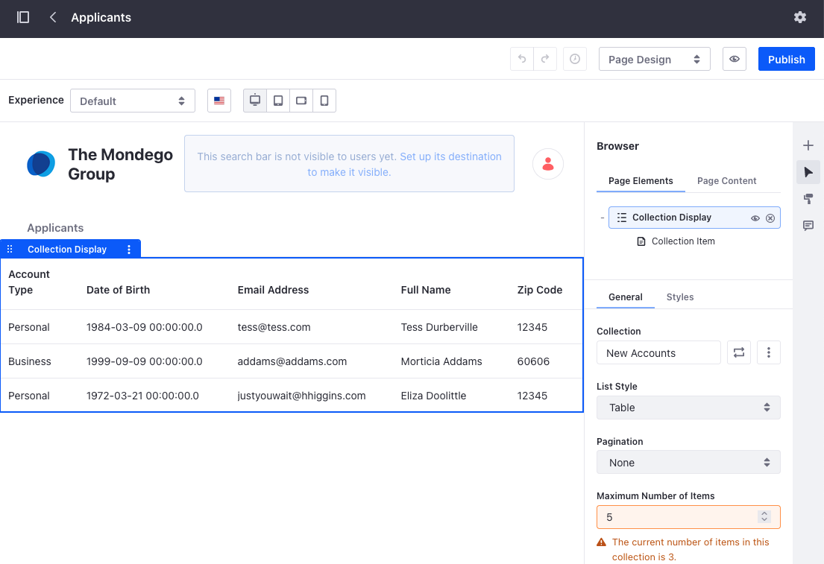
Using Collection Displays for Object Entries
Object entries can be displayed using the Collection Display fragment
Layouts include Grid and Table
Display Page Templates can be used to display each entry in a Collection Display as its own page:
Set the Content Type of the Display Page Template to the desired Object
Determine the template layout and set it as the template for the Object
Notes:
Notes:
The two default options for the Collection Display fragment layout are Table and Grid
Select the Object Entries you want to display by going to the General tab and the Collection section. Available Objects are listed under the Collection Providers tab.
Use Case:
Using a Collection Display fragment, Mondego can quickly display all Object Entries on a page. For example, they want to include an overview of all recent applicants on the Page “Applicants.” To make each entry appear on its own page so that they can concentrate on each individual, the web team creates a Display Page Template for New Accounts which turns each entry into a link that redirects to a Page with only that individual’s information.

Slide 27
Integrating Objects with Assets
Info TBD
Notes:
Note: Collection Displays and Display Page Templates represent Objects being integrated into the Asset Framework. This slide can be removed.

Slide 28
Headless Framework Integration
Info TBD
“This includes Liferay automatically generating Headless REST APIs for every Object, so you can interact with your Objects through defined endpoints. These APIs can also be used with the Job Scheduler integration to configure Talend jobs to dynamically sync Object data with external systems.”

Slide 29
Use Case: Mondego Objects
By taking advantage of the automatic integration of Objects with Liferay’s core Frameworks, Mondego can:
Create a Form integrated with the New Account Object so users can easily submit applications to open new accounts
Add a Workflow to New Account entries, requiring all new entries to be reviewed by two separate reviewers before the submissions are approved or rejected
Display all New Account entries on a private page on the Mondego Site using the Collection Display fragment and create links to view each unique entry by applying a Display Page Template

Slide 30
Knowledge Check
Liferay Objects are fully integrated with Liferay’s Core Frameworks, so Mondego can immediately leverage those capabilities, including:
Managing who has access to Object entries with Permissions
Assigning a Workflow to entries so that changes are reviewed before they are published
Mondego can set Forms to store data in an Object so that new entries can be added by general users and still be saved to the Object database.
To display Object entries, Mondego creates a new Content Page with a Display Collection fragment. Applying a Display Page Template to the Object allows each entry in the table to link to a distinct page.

Slide 31
Knowledge Check
Liferay Objects are fully integrated with Liferay’s Core Frameworks, so Mondego can immediately leverage those capabilities, including:
Managing who has access to Object entries with Permissions
Assigning a Workflow to entries so that changes are reviewed before they are published
Mondego can set Forms to store data in an Object so that new entries can be added by general users and still be saved to the Object database.
To display Object entries, Mondego creates a new Content Page with a Display Collection fragment. Applying a Display Page Template to the Object allows each entry in the table to link to a distinct page.

Slide 32
Exercise: Integrate Objects with Forms and Workflows
Notes:
Exercise Title
Use this slide to indicate that the following slides outline an exercise associated with the topic that is being covered. If a topic has multiple associated exercises, place one of these slides before the first exercise and between each of the subsequent exercises.

Slide 33
Integrate Objects with Forms and Workflows Exercise Objectives
Integrate the New Accounts Object with a Form
Create a Workflow for Approving New Account Entries
Display the New Account Entries Using a Collection

Slide 34
Integrate Objects with Forms and Workflows Exercise Steps
Create a New Account Application Form
Integrate the New Account Application Form with the New Accounts Object
Create a Workflow for New Account Application Form Entries
Submit an Entry for the New Account Application Form
Review the New Account Entry
Create a Display Page Template for New Account Entries
Create a Private Page to Display New Account Entries

Slide 35
Integrate Objects with Forms and Workflows Bonus Exercises
Create a workflow for reviewing PTO requests that includes at least two different reviewers. Submit a request and go through the approval process using the newly created workflow.

Slide 36
Summary (1/3)
Liferay Objects is a tool that businesses can use to build and deliver custom, low-code applications within the Liferay DXP UI.
Objects are created using the Objects portlet where a draft is created, assigned fields, scopes, and relationships, and finally published, which creates the new application within the platform.
Fields are data definitions that represent a database column and store different types of values for Liferay Objects. They operate similarly to the fields found in the Forms application.

Slide 37
Summary (2/3)
Relationships are connections between Objects and can be either One to Many or Many to Many.
Object Layouts define how fields and relationships are organized and displayed and can be presented in either single or multi-tab arrangements.
Upon publication, the following takes place for a new Object: a database table is created for the Object with the data definitions, a new Headless API is created for CRUD operations, a Collection Provider is created for displaying Object entries, and the Object is integrated with the Info, Permissions, Workflow, and Form frameworks.

Slide 38
Summary (3/3)
Once created, Objects cannot be deleted or changed in name or scope.
From the time of their creation, all Objects are fully integrated with Liferay’s core frameworks including permissions, workflows, Assets, and Headless APIs.
Forms can be used to easily collect and store entries in an Object’s database.
Object entries can be displayed collectively using a Collection Display Fragment or individually using Display Page Templates.

Slide 39
For Further Reading
For more information regarding this module’s topic, consult the documentation here:
https://learn.liferay.com/dxp/latest/en/developing-applications/developing-low-code-applications/objects/introduction-to-objects.html
For general questions about using Liferay’s products, visit:
https://learn.liferay.com/index.html

